Slide 1

The Use of AI for Network Automation and Network Optimization
Colt Technology Services
Berkeley Innovation X-Labs
Sutardja Center for Entrepreneurship & Technology
Notes:
Created Summer 2021

Slide 2
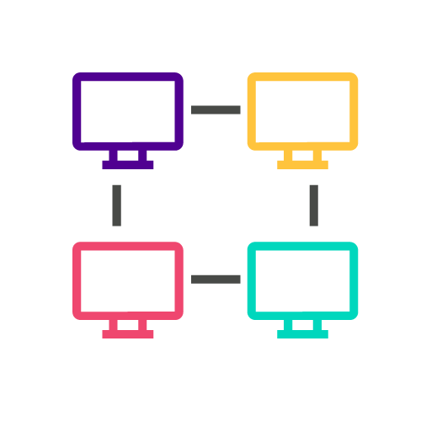
Network Automation and Optimization
(WHAT) Control graph network based on data we get from services to (WHY) provide better network experience on the link.
Goal: Watch network traffic and make guesses of how much particular application uses in terms of mean, variance, etc.
Description: Automatically adjusting certain elements of the network (look at data collected by probes) based on traffic conditions so more bandwidth can be added between locations. Can use data to make decisions about how to improve performance with delay of packet times. Parameters we want to control to enable quality of experience for certain applications: increased bandwidth and reduced delay.
Validation information: “We (the Colt team) need intelligence from data that tells us about degradation of services.”
Notes:
the problem
statistical multiplexing
measures of current qos, bandwidth, and the delay

Slide 3
Dynamic SLA in AR/VR Applications
Idea: Algorithm that takes in loss/ flow of network traffic and returns number for what to set bandwidth as
(1) watch traffic
(2) tell characterization + pull what application is doing
(3) give number for bandwidth
phase 1: take data from network and provide information about performance
automatically decide what to change to follow needs of traffic
phase 2: measuring and characterizing dynamic service-level agreement (SLA) in AR/VR applications
Notes:
the solution

Slide 4




Technical Components
Components required in order of importance:
Python libraries: python, numpy, scipy, tensorflow, keras, etc.
DEMO: Apache zeppelin, streamlit, github
What information is easy to get as an input (available data), can put probes in network (application server) to get data from server
We know network is made out of nodes and links. What is the function of the nodes? Content delivery?
Mathematical computations. Resource: Ikhlaq
UI component: control from the bandwidth, measure network traffic.What kind of UI will let you take data but provide the value of the settings
Green & Orange: Easy to develop
Red: To learn
Notes:
DEMO with analytics partner: real time effect of changing bandwidth performance in test environment
kpi of network
tomorrow: list of protocols
nodes are routers and bandwidth between can be controlled by network below (segment routing, etc.)
UI: show statistics of application performance and set bandwidth (remotely connect to clients)

Slide 5



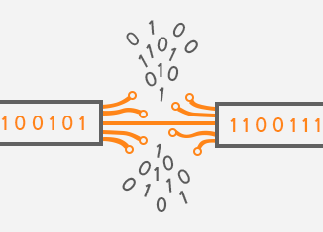
Colt-X System Architecture
Tier 1: Possible Inputs for Colt
Tier 2: Application of input from Colt to train, test, and split data
Tier 3: Possible Result for Colt
Reinforcement learning: pytorch, python, numpy, scipy, Tensorflow, Keras, etc.
Data visualization, statistic characterization, statistical multiplexing
Mathematical Computations: mean, peak variance, standard deviation
MPLS
VR
KPI
VM
(need to improve: unsure)
Log event data about network traffic
(Unsure)
QOS: Increased User Happiness
Optimize Bandwidth for minimum cost
Quantifying quality of service on background traffic
Pandas: Short
Term Storage
Long Term Storage: Python and File Formats (Excel, CSV, Log Event Data)
Reduced packet loss
Feedback from Colt Technology Services
Notes:
QOS: increased user happiness
Optimize bandwidth for minimum cost
Reduce packet loss
*what does the screen interface look like → screen with input section (desired qos) and output (graph of network and measures of qos and bandwidth currently and delay that network experiences on link)
→ brainstorm on top of design that colt finds valuable

Slide 6
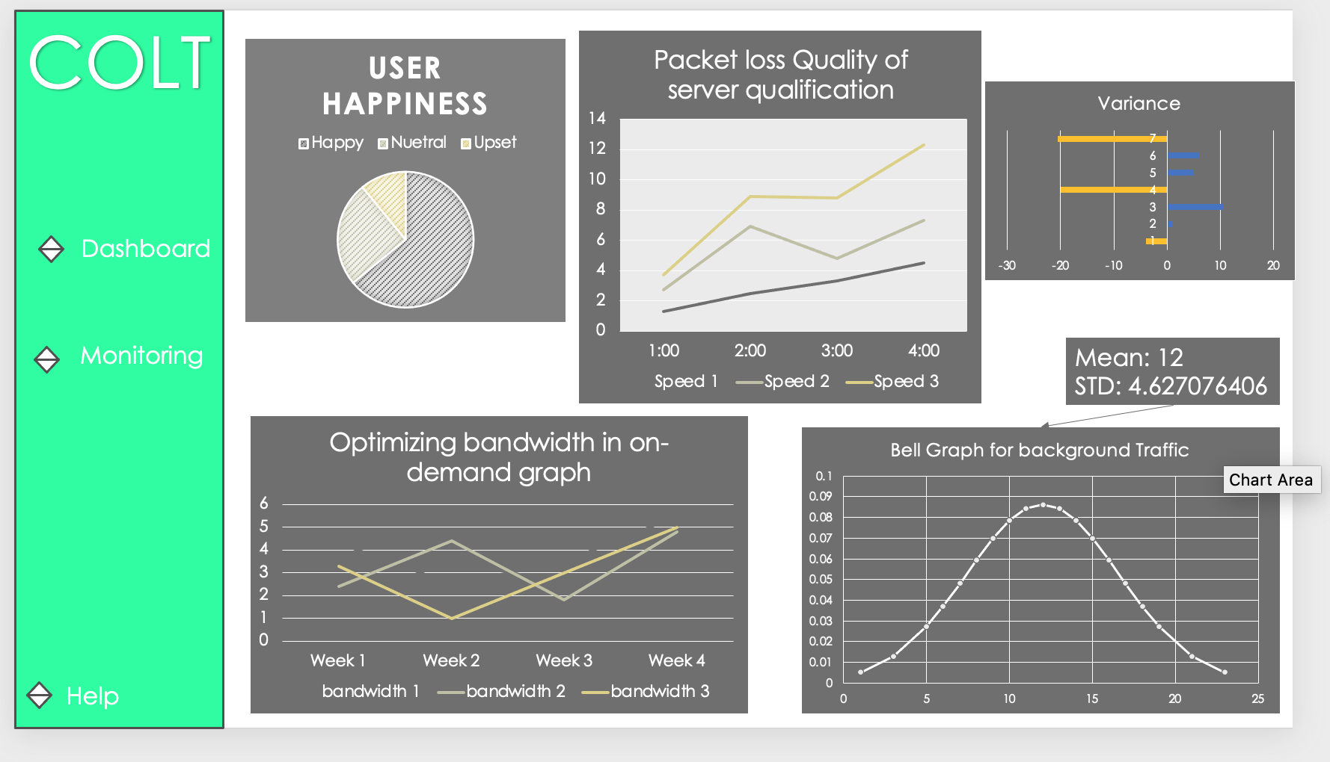
User (Colt) Perspective
Notes:
What type of data are we getting?
What should our output be?
optimization: decrease bandwidth and reduce cost without tradeoff (set bandwidth to optimize cost while maximizing delay and user happiness)
network data → configuration (algorithm or system) with help from Ikhlaq → bandwidth on one link (kpi of application and expense of users)
input data is quantifying quality of service (how good you want quality to be at application level and sets bandwidth for whole link)
vr application: only want one vr qs to control bandwidth (adding background network traffic)
idea: background traffic → statistic characterization (mean, variance, peak, etc. of distribution) → same thing from source itself (vr application) can measure in isolation
changing bandwidth: line plot (bandwidth on y axis and time on x axis)
analytics (real time effect on data): bell curve for stats and print out analytics in dataframe
kpi
remote connection to client : check responsiveness

Slide 7
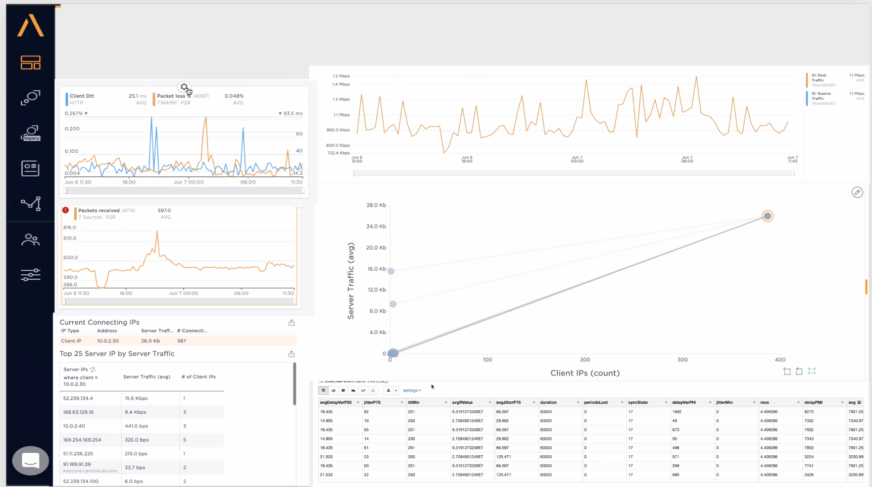
User (Colt) Perspective
Top three user requirements:
Optimize bandwidth for minimum cost
Reduced packet loss
QOS: Increased user happiness (from the customer perspective)(UI)
Questions for the Colt team:
Are we creating an extension of an existing UI used by your team that displays data collected?
What are some of the visual components that should be a part of the UI? EX: Output about the specific applications, data visualizations for non-technical audience
Notes:
What type of data are we getting?
What should our output be?
optimization: decrease bandwidth and reduce cost without tradeoff (set bandwidth to optimize cost while maximizing delay and user happiness)
network data → configuration (algorithm or system) with help from Ikhlaq → bandwidth on one link (kpi of application and expense of users)
input data is quantifying quality of service (how good you want quality to be at application level and sets bandwidth for whole link)
vr application: only want one vr qs to control bandwidth (adding background network traffic)
idea: background traffic → statistic characterization (mean, variance, peak, etc. of distribution) → same thing from source itself (vr application) can measure in isolation
changing bandwidth: line plot (bandwidth on y axis and time on x axis)
analytics (real time effect on data): bell curve for stats and print out analytics in dataframe
kpi
remote connection to client : check responsiveness

Slide 8
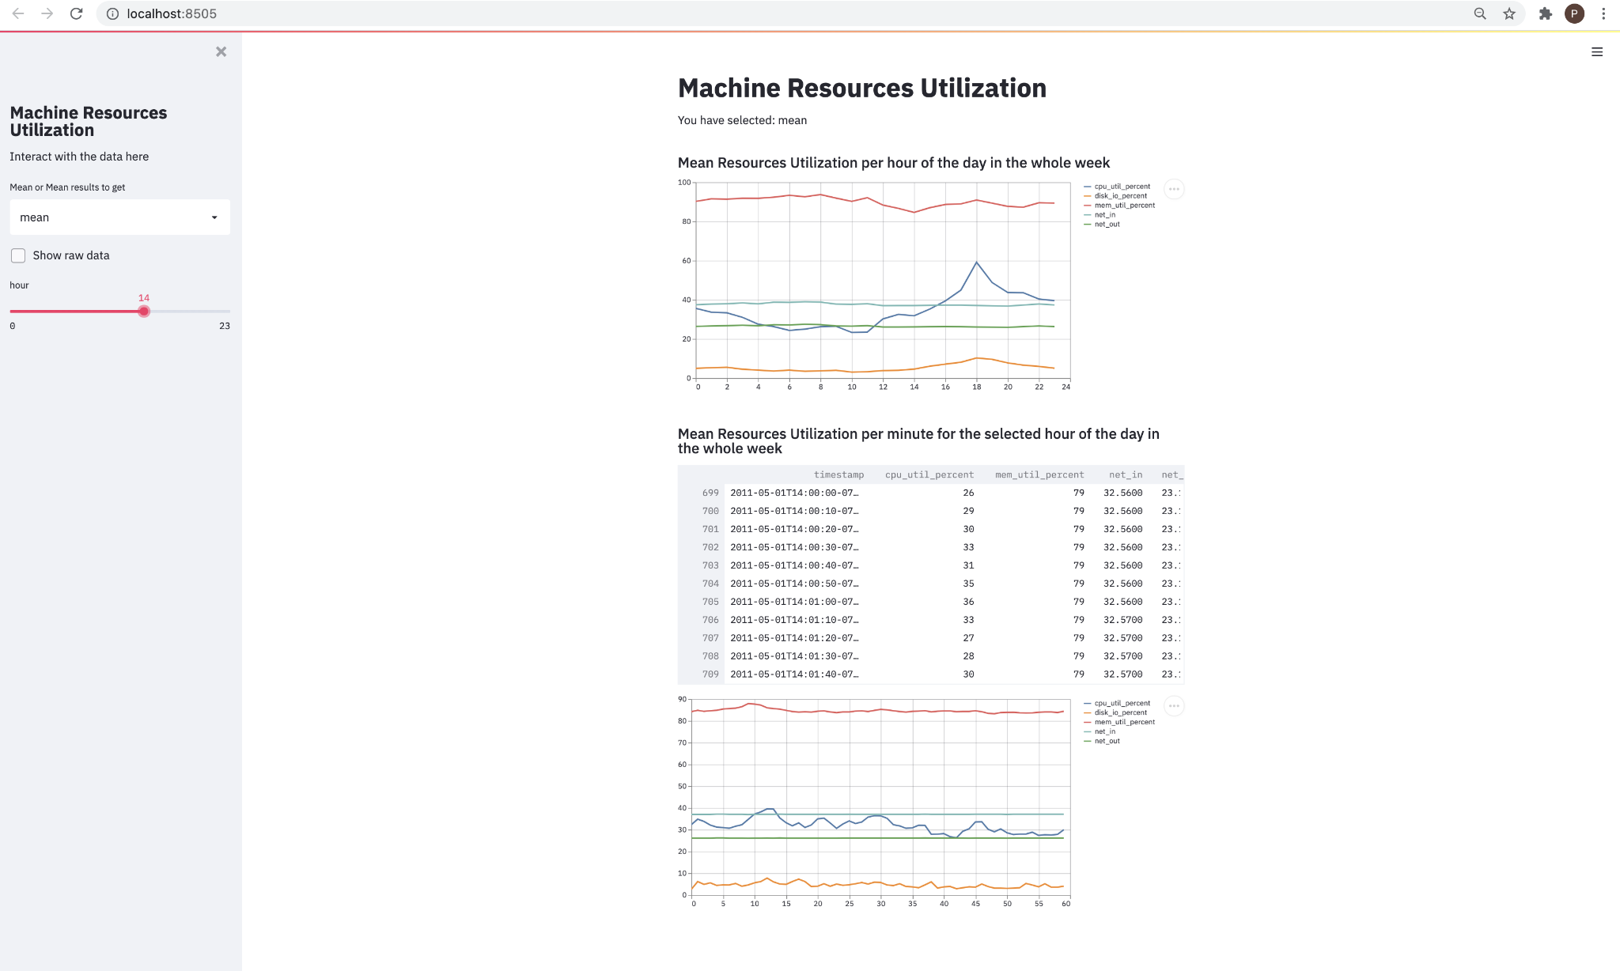

Slide 9
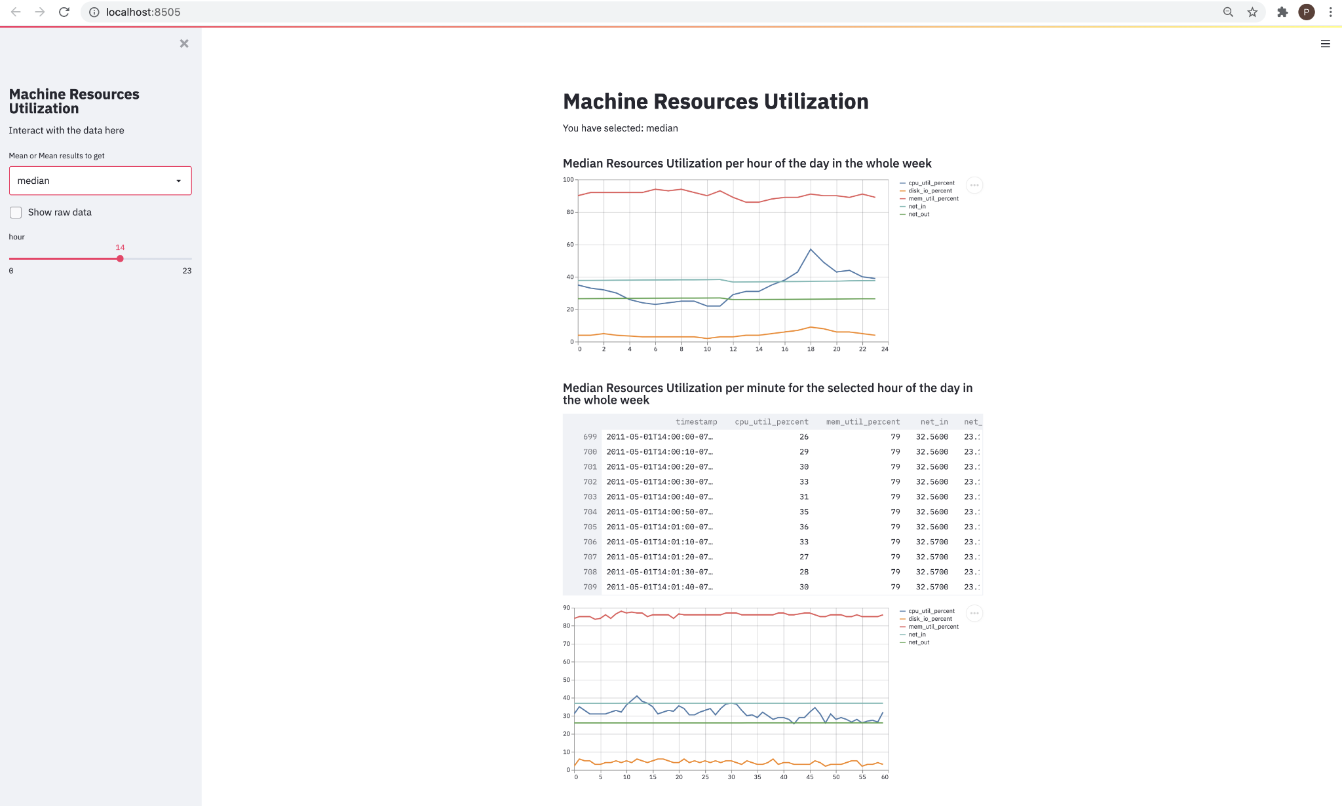

Slide 10
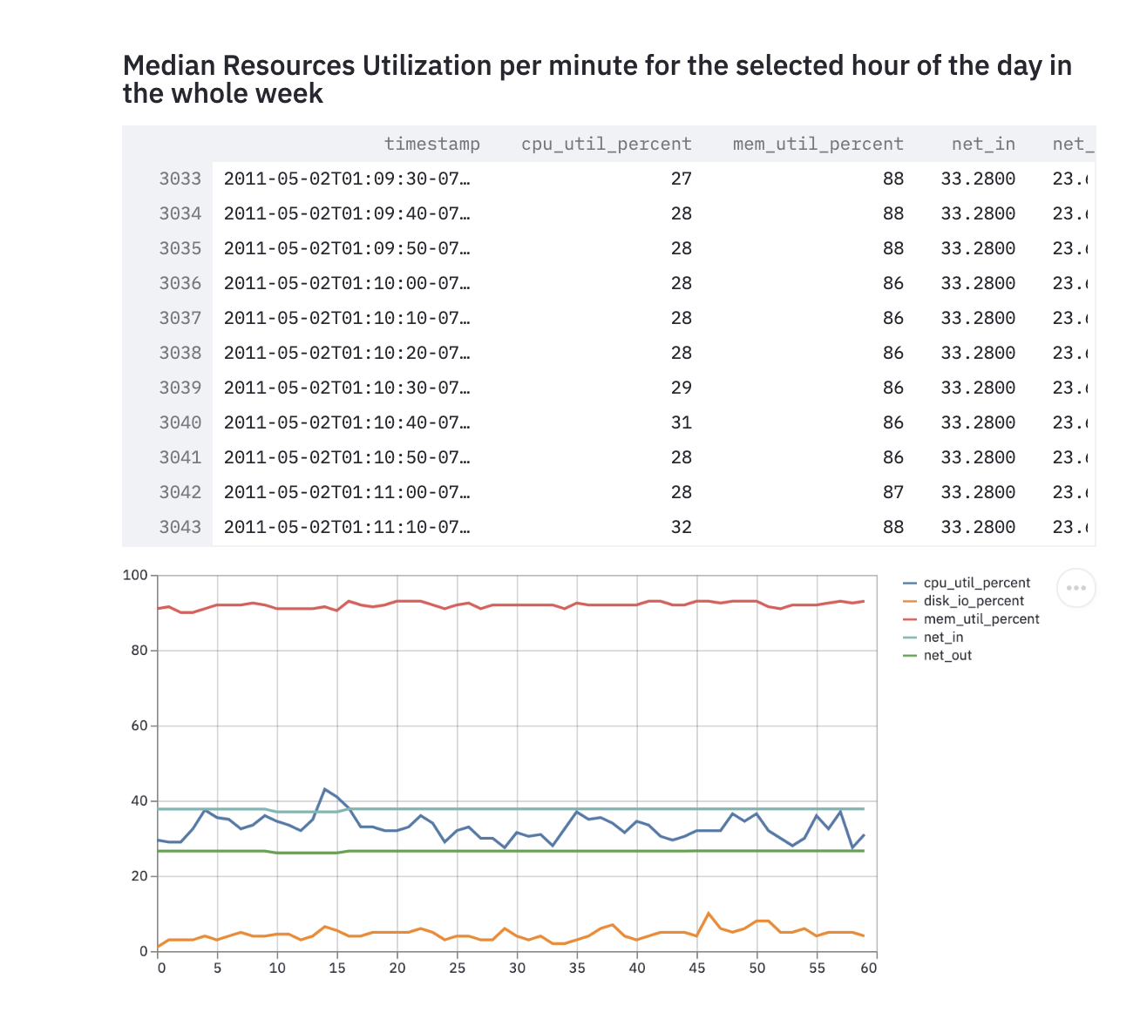
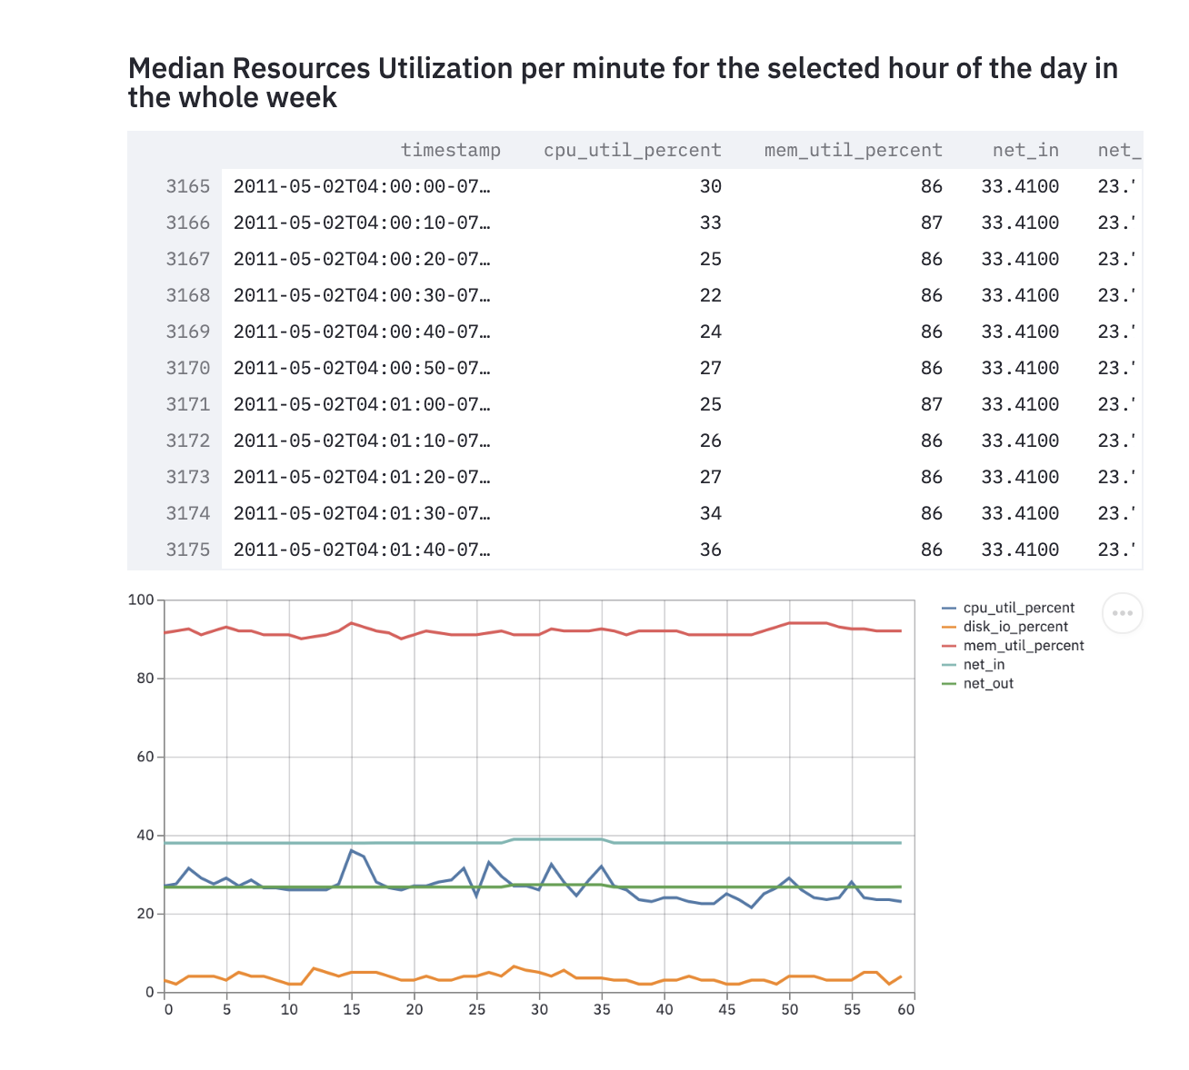

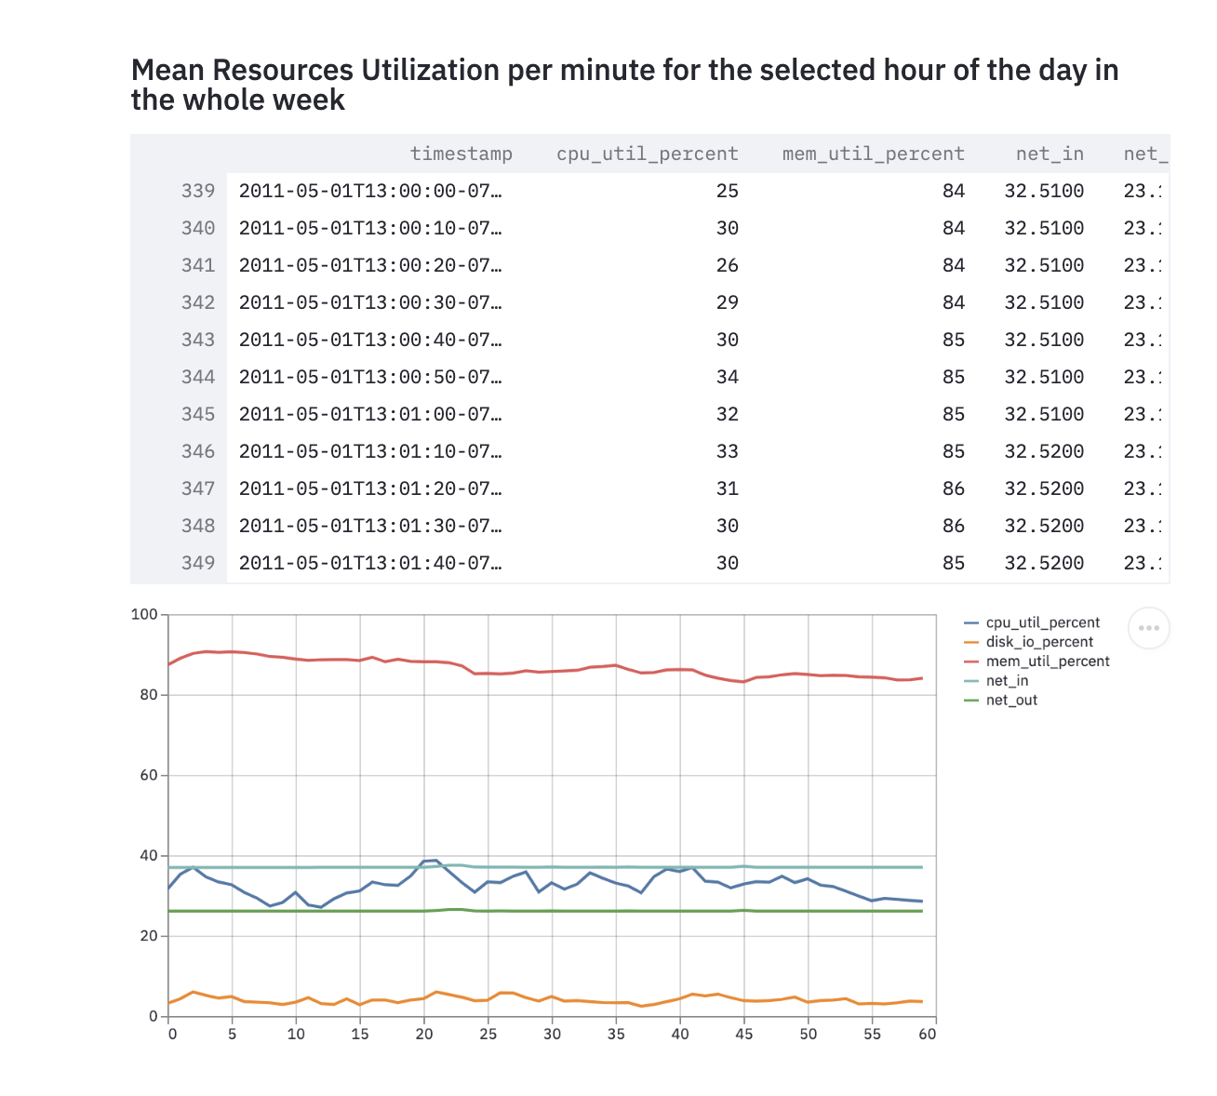
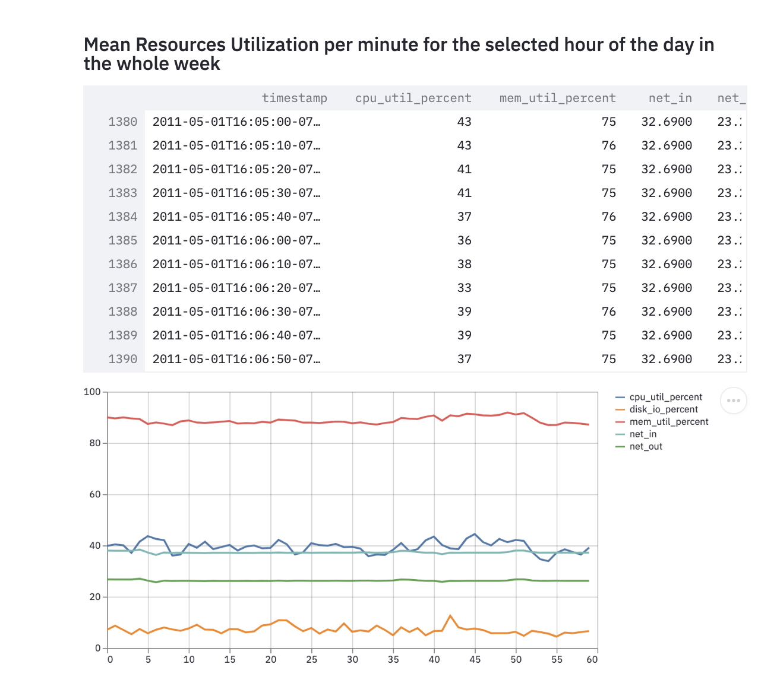
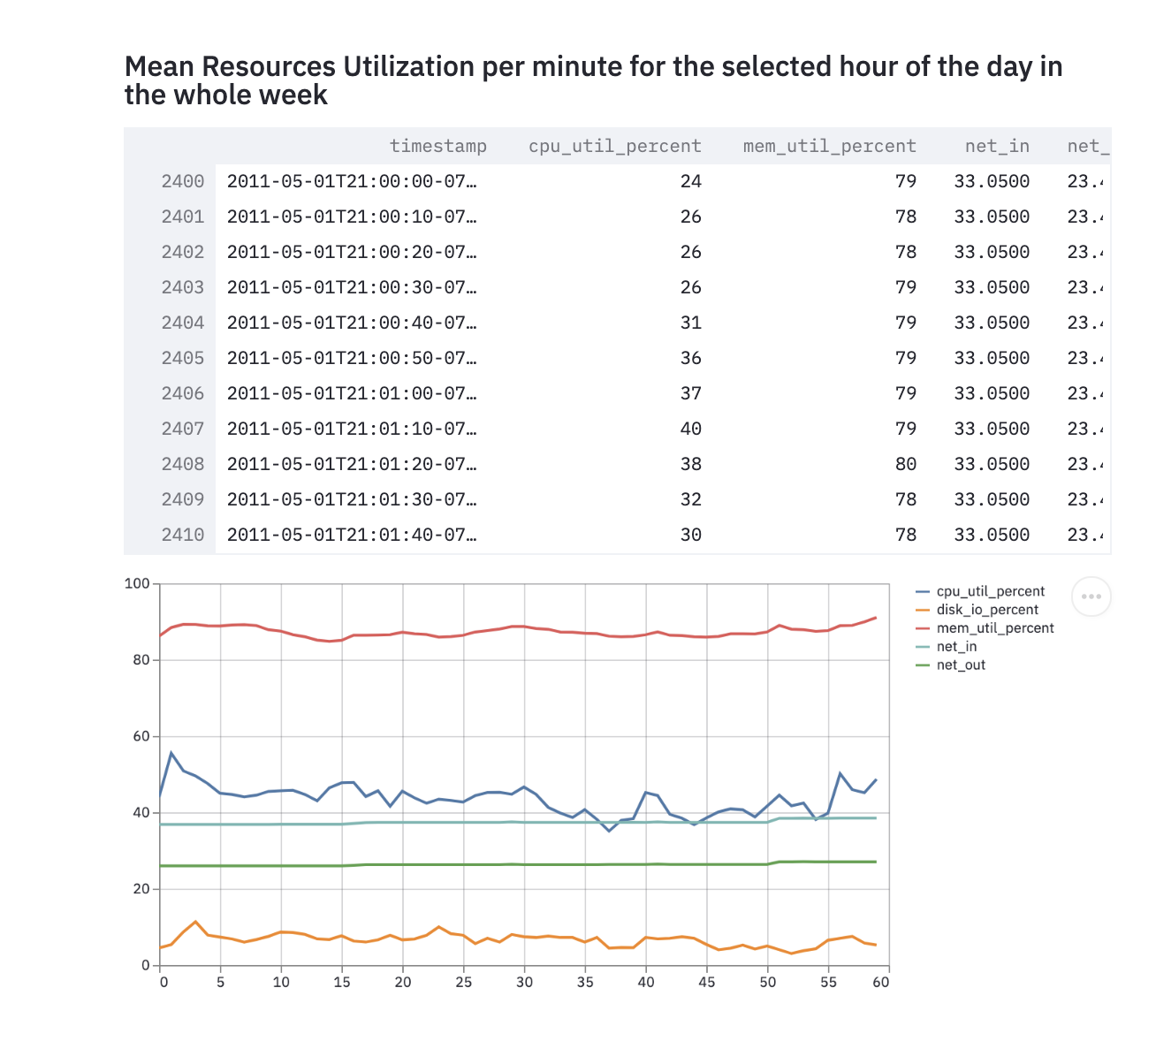

Slide 11
What will we do next?
Brainstorm Challenge and Validate
Propose Low Tech Solution
Execute, Iterate, Expert Feedback, Reflections, Agile Sprint
DEMO
Goal: automate analysis of network traffic data → report stats of application use
Is the data we will be provided with log event data on network traffic? When can we expect to receive it?
Information from Ikhlaq on what mathematical computations we should read up on
Research → Normalize Concepts → Technical Demo of Minimal Demonstrable Version

Slide 12
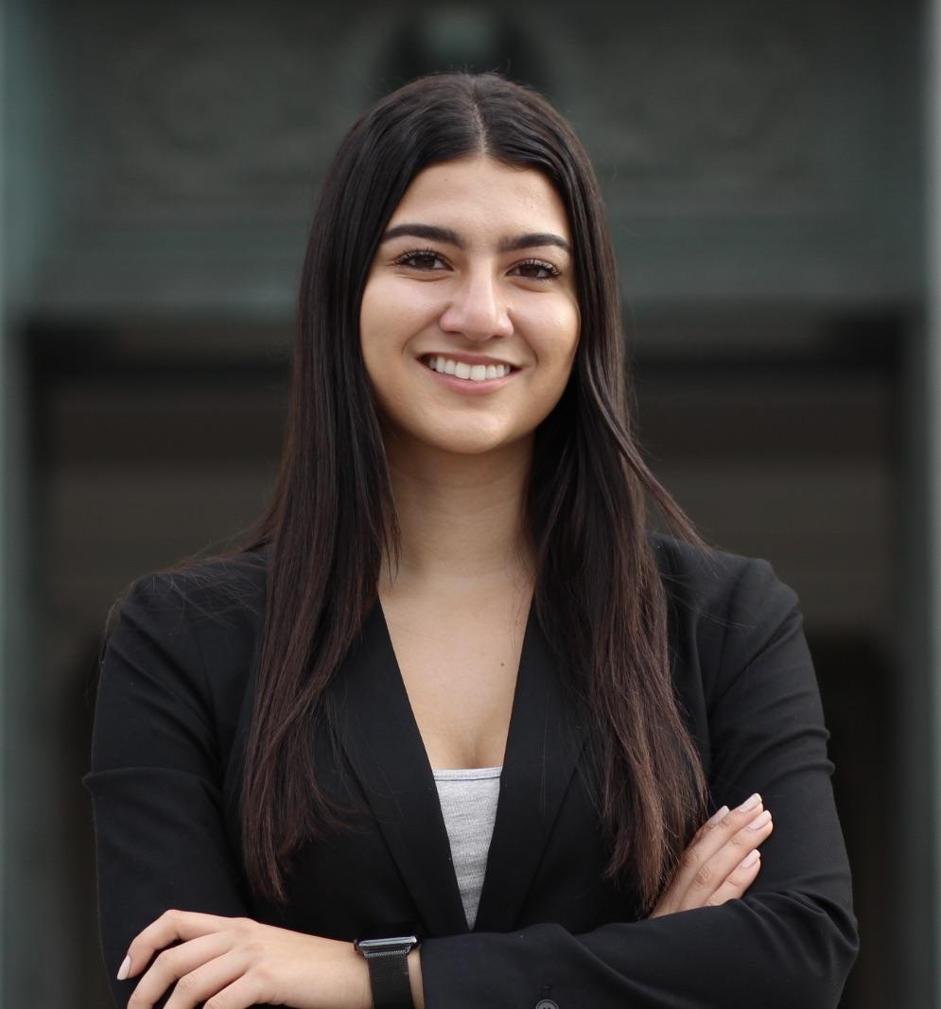



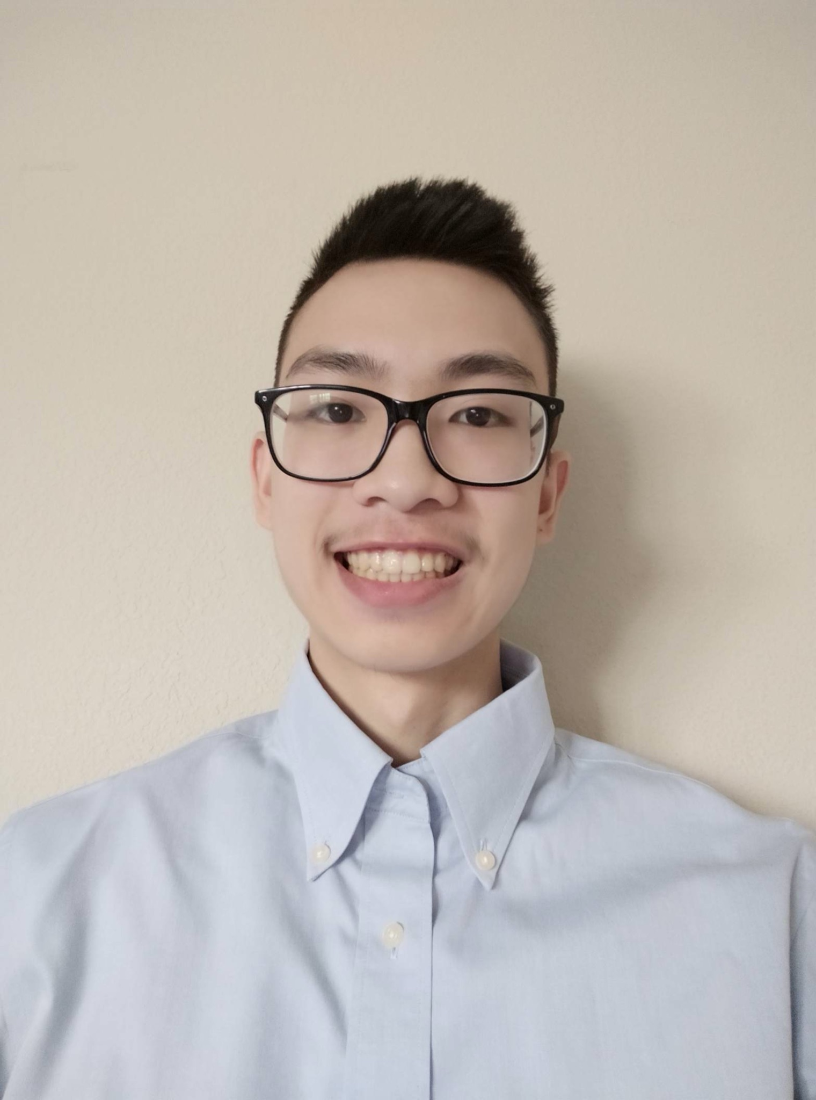
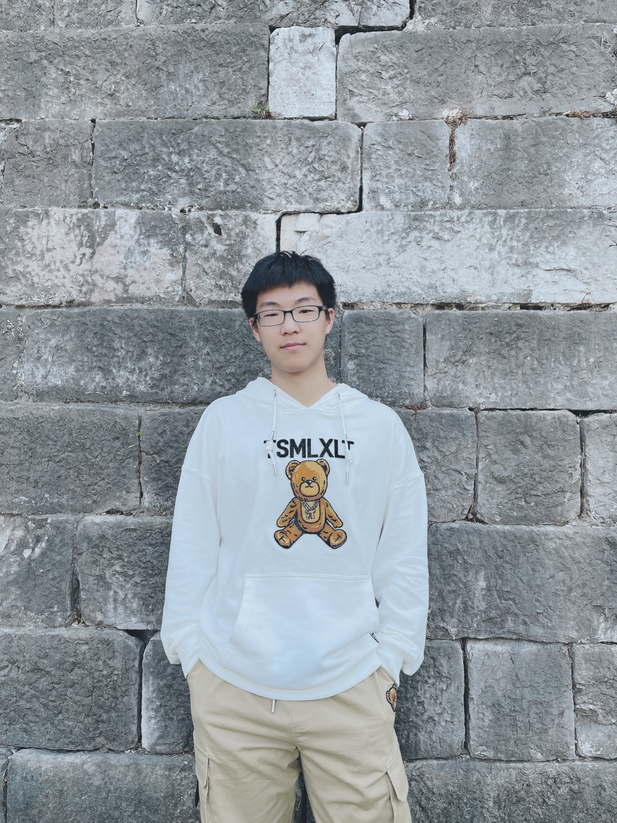
Meet the Innovation-X Team
Isabel Zavian
Senior
Economics & Data Science
Management Lead
Noor-Ul-Ain Ali
Senior
Data Science
Technical Lead
Ronel Solomon
Junior
Data Science
Technical Member
Charline Shen
Junior
Computer Science & Physics
Volunteer Intern
Andy Lam
Senior
Mechanical Engineering
Volunteer Intern
Peter Li
Sophomore
Applied Math & Computer Science
Volunteer Intern

